Slide 1


EMPIRICAL EVALUATION OF EYE DISEASE DETECTION THROUGH MACHINE LEARNING TECHNIQUES

Slide 2


GROUP MEMBERS
Manoj Kumar Bonu -700740713
Kishore Simhadri - 700739776
Ravali Budidhi - 700727355
Dhheeraj Boleenenni- 700727909

Slide 3
RESPONSIBILITIES
Manoj Kumar Bonu
Worked on Dataset, Data Preprocessing, SVM, Documentation.
Kishore Simhadri
Worked on Dataset, Data Visualization, Naive Bayes, Documentation.
Ravali Budidhi
Worked on Dataset, Decision Tree.
Dhheeraj Boleenenni
Worked on Dataset, Logistic Regression.

Slide 4


MOTIVATION
Machine Learning Engineer must spend lots of time pre-processing or purifying data before creating a model from scratch, and the vast majority of Machine Learning Engineers devote a considerable deal of time and effort to this aspect of their job.
Outlier detection and treatment, missing value treatment, and the elimination of undesirable or noisy data are a few examples of data pre-processing techniques.
In order for machine learning to be performed in accordance with medical guidance, pre-processing must be undertaken. This includes data cleaning and normalization, as well as noisy data filtering and missing value handling.

Slide 5


OBJECTIVES
Fortunately, standard taxonomies reduce redundant information, ensuring that no aspect is overlooked during the analysis and diagnosis process.
Missing values might also have a negative impact on machine learning.
Specifically, two strategies were used in this study to deal with missing values: first, the deletion of records that had more than 60% of their values missing, and second, a two-step diagnostic method using segmentation.

Slide 6


RELATED WORK
Cataracts, iridocyclitis, and corneal haze are all prevalent eye problems in the elderly. Using machine learning techniques, a computer-based smart system was created to categorize various eye illnesses.
For each form of eye illness, characteristics are retrieved and employed by the classifiers, which include SVM, logistic regression, naive Bayes, and decision trees.
Illness criteria are built for the fuzzy-based classifier. Additional guidelines for different illnesses may overlap and be difficult to distinguish from photographs.
To begin, characteristics are extracted from photographs of each illness and treated as symptoms. Expert rules are then built around these aspects.
Finally, a decision tree classifier is created using forward chaining and depth-first search to complete the classification.

Slide 7
PROBLEM STATEMENT
Vision loss and blindness can be caused by several factors. These factors can be genetic, environmental or accidental.
In the near future, the number of patients suffering from eye diseases is expected to increase dramatically due to aging of the population.
In such a scenario, early recognition and correct management of eye diseases are the main objectives to preserve vision and enhance quality of life. Deep integration of artificial intelligence (AI) in ophthalmology may be helpful at this aim, having the potential to speed up the diagnostic process and to reduce the human resources required.
Machine Learning is a subset of computer science that deals with using computers to develop algorithms that try to simulate human intelligence

Slide 8
PROPOSED SOLUTION
Data Preprocessing: The eye disease dataset contains two parts where one consisting of images and another one consisting of labels. Here, the labels dataset is again divided into three parts which are category, type, and grade. The total images consisted of 712. Later, we resized to 100, 100 pixels in size.
Splitting of Data: To avoid overfitting, the dataset was divided into two categories: training datasets and testing datasets, which were divided by 80 percent and 20 percent, respectively.
Model Training: In this project, we will use various ML algorithms to classify the disease and compare the performance of the model. Algorithms are, • Logistic Regression• SVM • Decision Tree • Naive Bayes. We have trained the model by using the above algorithms.
Prediction: In classification, when we say "accuracy" we are usually referring to the degree to which something is accurate. It is one of the more visible metrics because it is the total number of cases that have been accurately detected. The best model is identified by the highest value of accuracy

Slide 9
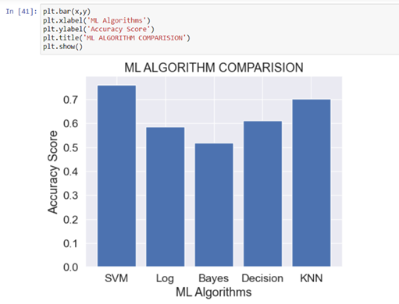

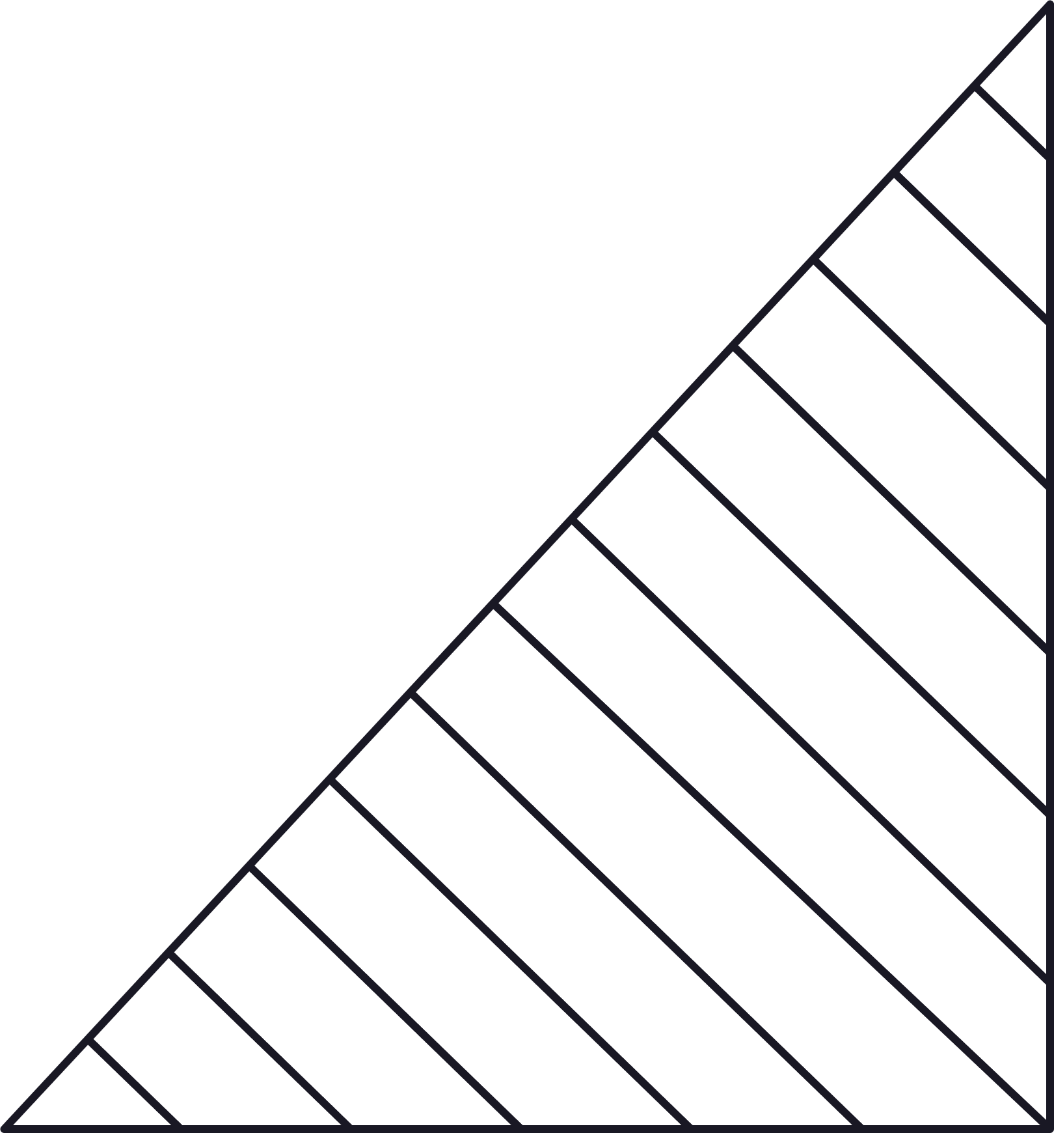
RESULTS
After applying all the algorithms to the data set, we obtained varied accuracy percentages for different methods and conducted visualization for data when a forest fire occurred, depicting the region of fire that occurred now.

Slide 10

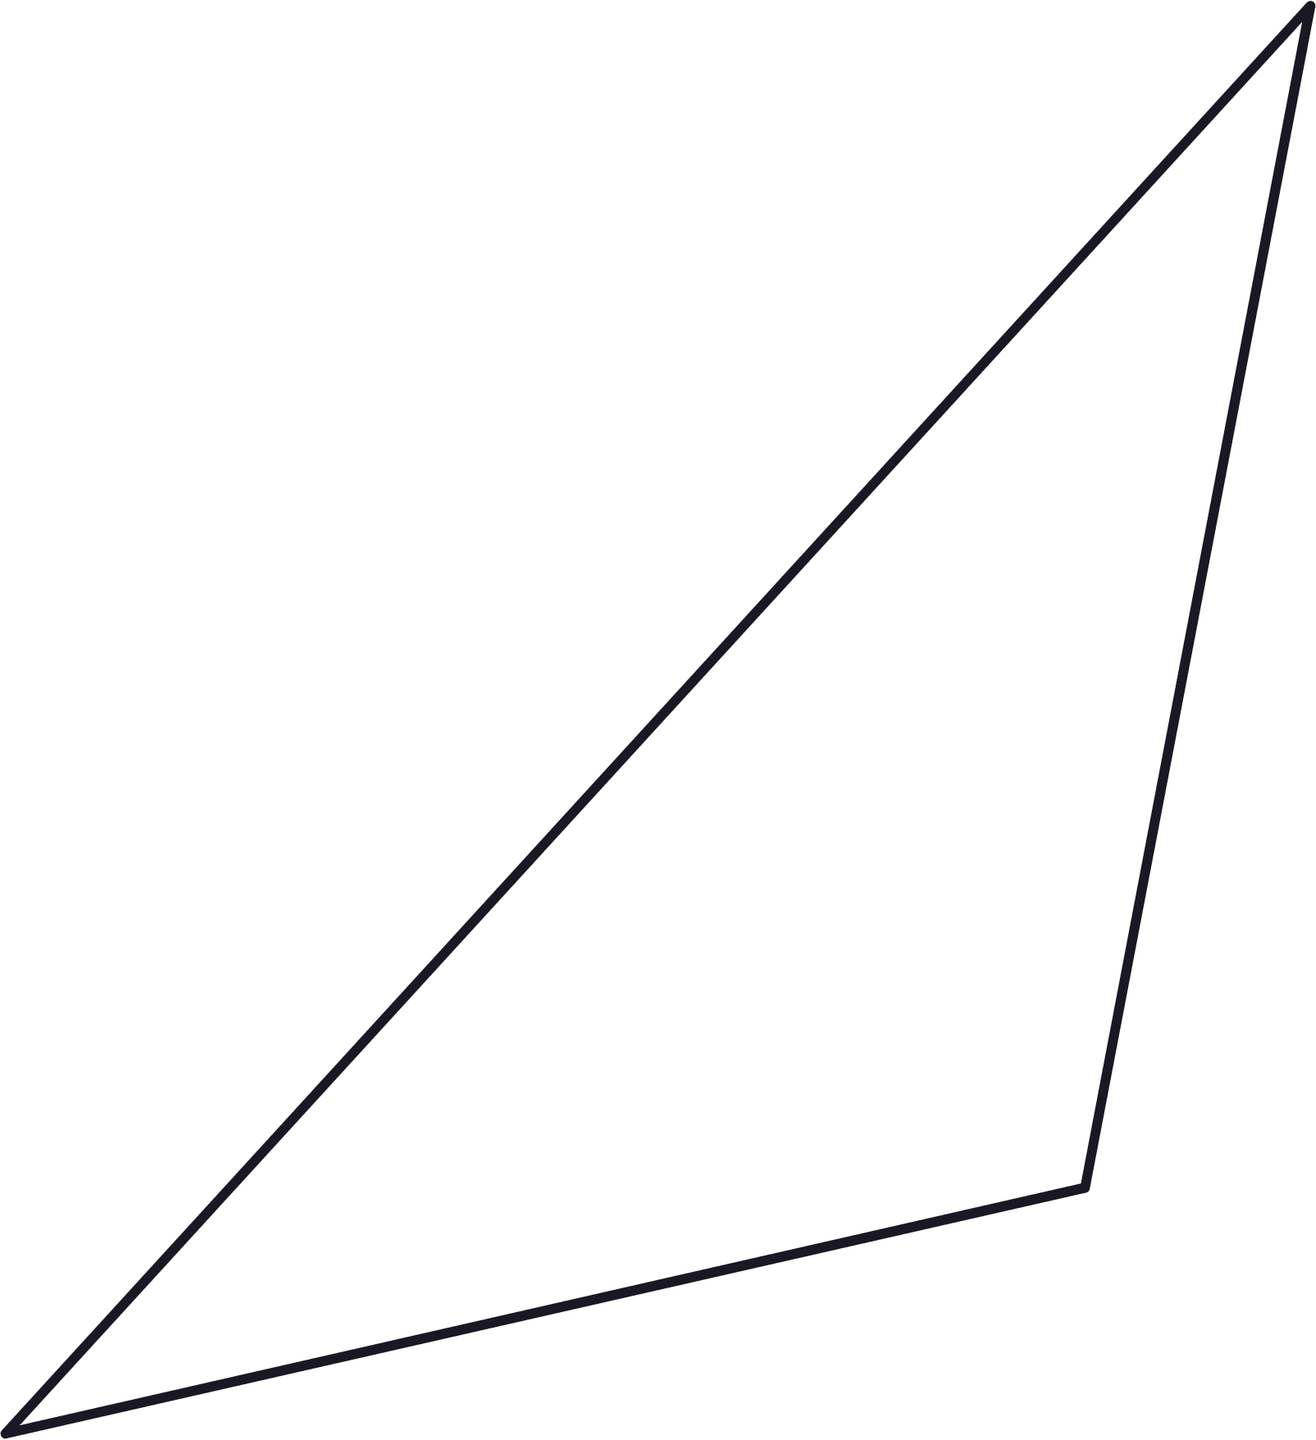
A Multiscale Optimization Approach To Detect Exudates In The Macula Carla Agurto, Victor Murray, Honggang Yu, Jeffrey Wigdahl, Marios Pattichis, Sheila Nemeth, E. Simon Barriga, And Peter Soliz.
Tae-Young Heo, Kyoung Min Kim 1, Hyun Kyu Min, Sun Mi Gu, Jae Hyun Kim, Jaesuk Yun And Jung Kee Min “Development Of A Deep-Learning-Based Artificial Intelligence Tool For Differential Diagnosis Between Dry And Neovascular Age-Related Macular Degeneration “.
Chatterjee .B.M. Handbook Of Opthalmology, 6th Edition Revised And Enlarged, New Delhi, Cbs Publishers & Distributers, 2002.
R. S. Rekhi, A. Issac, M. K. Dutta, And C. M. Travieso, ‘‘Automated Classification Of Exudates From Digital Fundus Images,’’ In Proc. Int. Conf. Workshop Bio Inspired Intell. (Iwobi), Jul 2017, Pp. 1–6.
P. Sermanet, D. Eigen, X. Zhang, M. Mathieu, R. Fergus, and Y. Lecun, OverFeat: Integrated Recognition, Localization and Detection using Convolutional Networks, 2014.
D. Erhan, C. Szegedy, A. Toshev, D. Anguelov Scalable Object Detection using Deep Neural Networks Proceedings of the IEEE conference on computer vision and pattern recognition (2014), pp. 2147-2154
REFERENCES

